Slide 1
Week 09
Keel Bone Chicken Project
10/24/25

Slide 2
This Week
Progress & Issues faced this week
Working Data Logger on Web Interface
Live Data Logging on Python Backend
New Circuits on Schematic
Layout Changes
Issues:
Still running into issues fitting the battery into the circuit

Slide 3
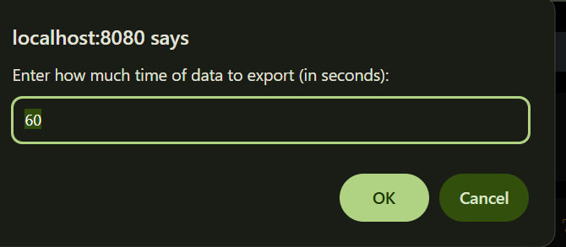
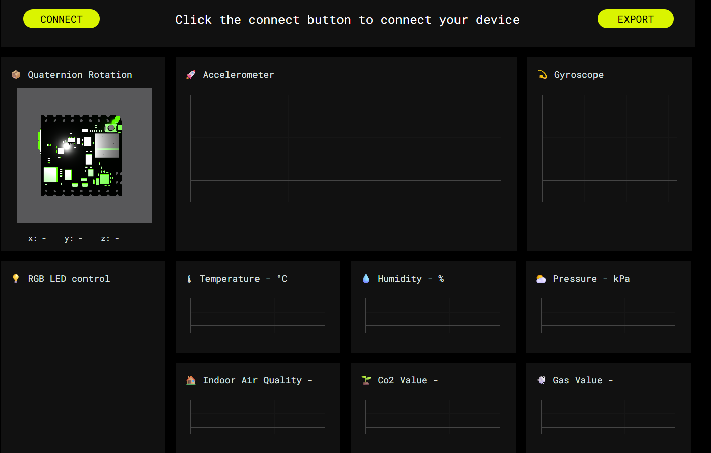
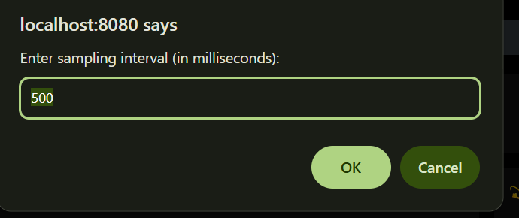
Working Data Logger on Web Interface
Introduction of Export button on UI for sensors
Previous time + sampling interval available to extract data
Data available with BLE only (no Wi-Fi)

Slide 4
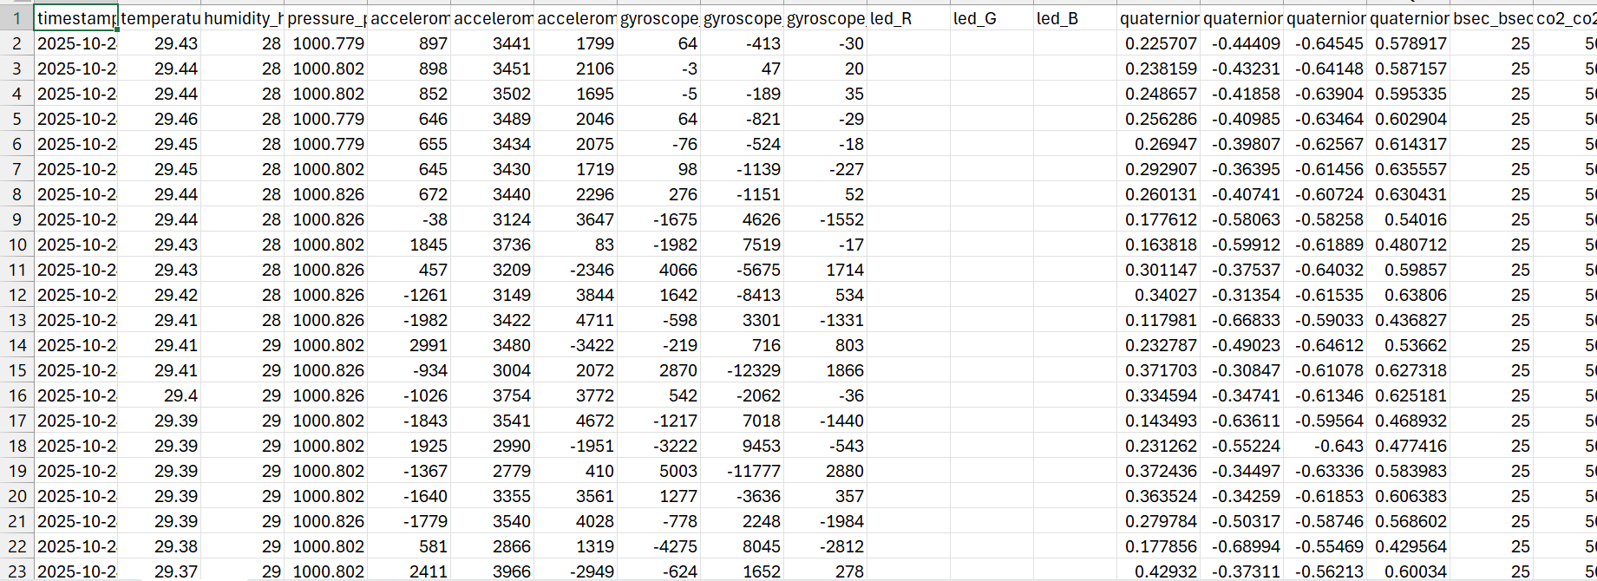
Working Data Logger on Web Interface
Data Logger works on http://localhost:8080
Able to compile data from all ports
Data easily captured using export button on web interface
Data logger working remotely

Slide 5
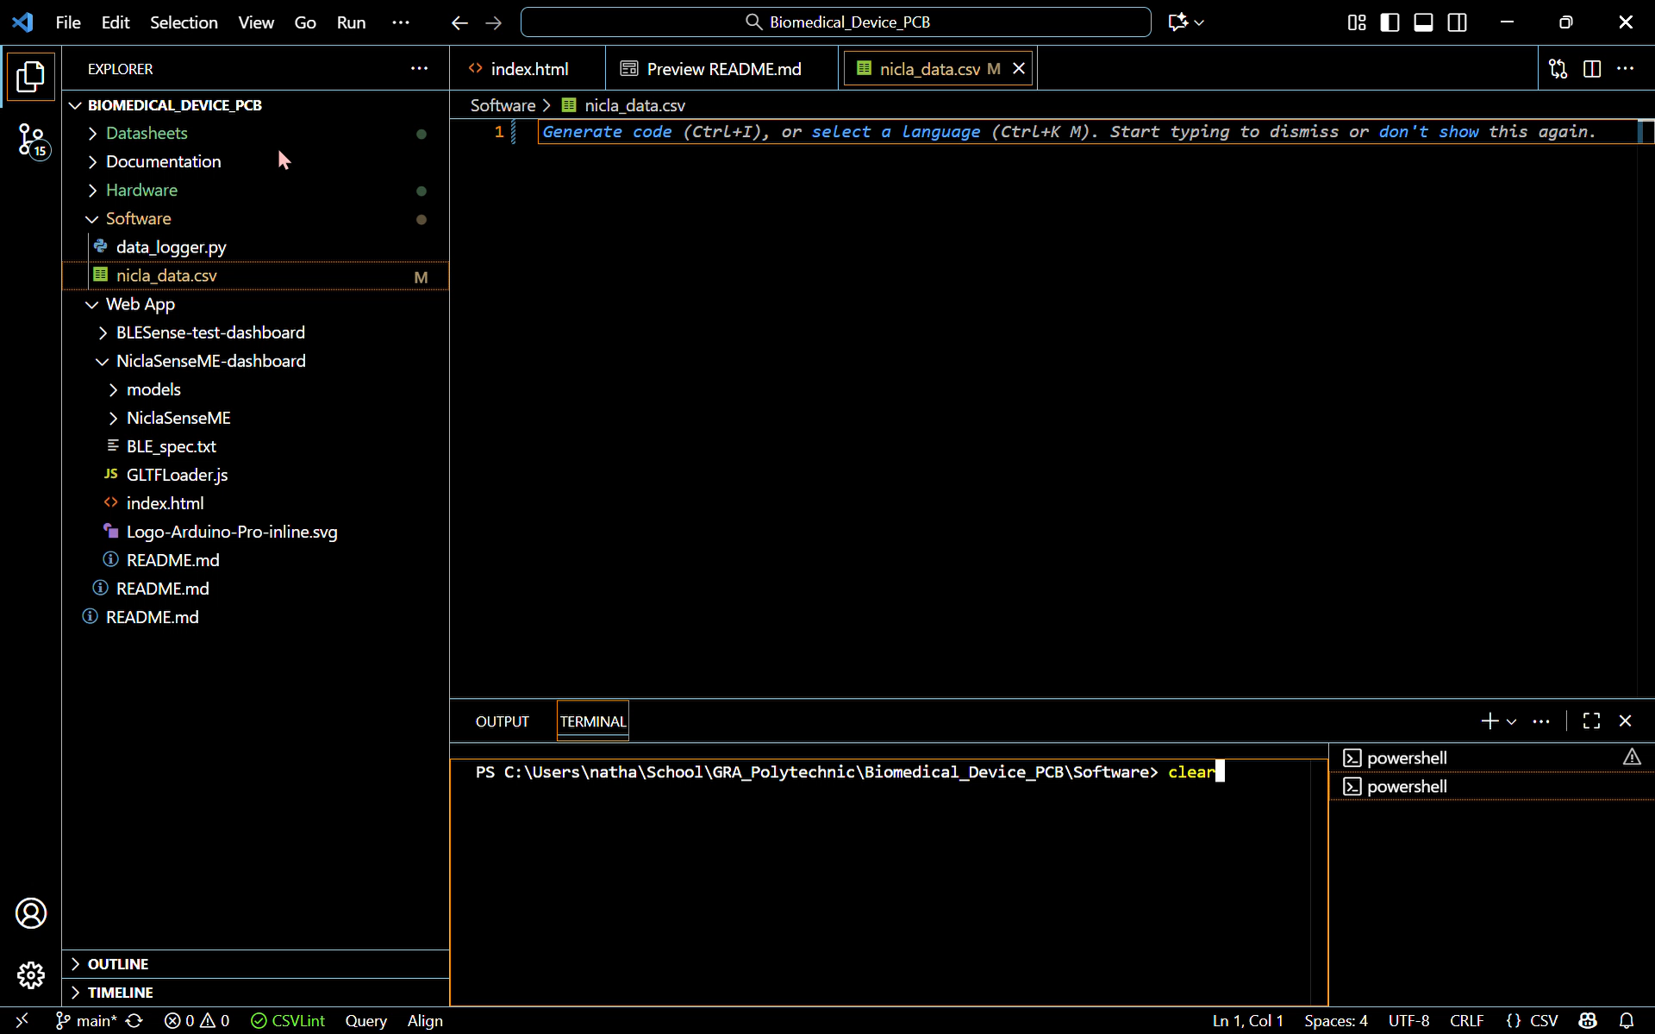
Live Data Logging on Python Backend
Program Arduino → Run Backend → See live data recorded
Live demonstration below:

Slide 6
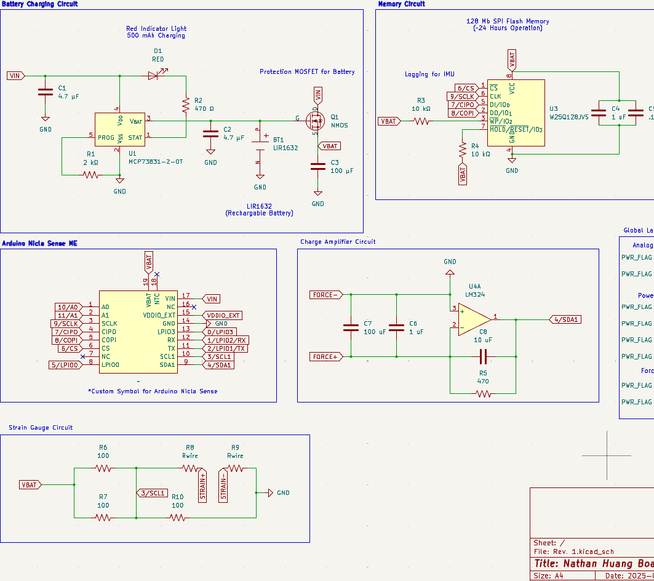
New Circuits on Schematic
Force and Strain (Last Two Sensors)
Area on SoC might be an issue in the figure:
Force Sensor (Charge Amplifier)
Strain Sensor (Wheatstone Bridge)

Slide 7
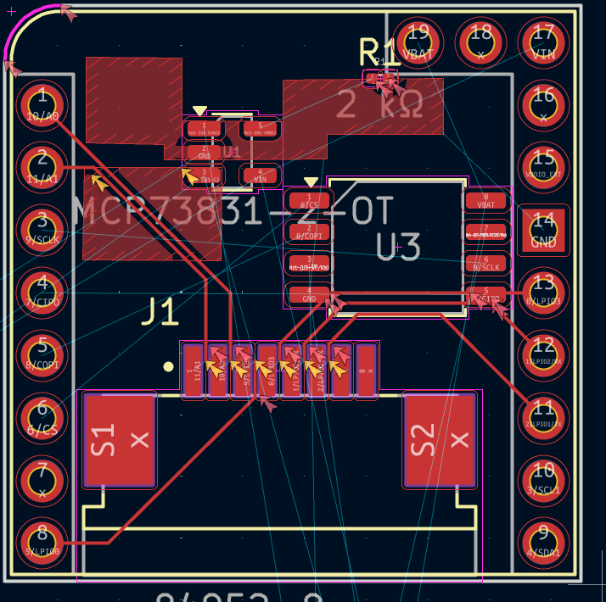
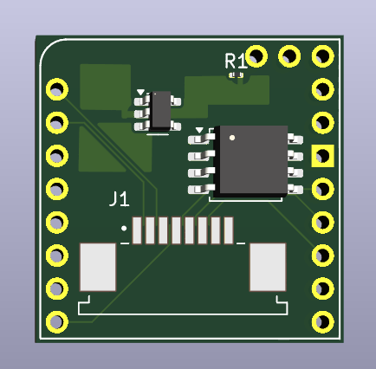
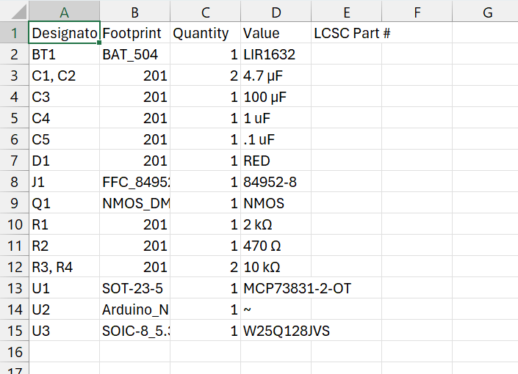
Layout Changes
Introduction of Ribbon Cable
BOM being generated for PCBA
Ribbon cable occupies ~20% of area
Could lead to a future issue

Slide 8
Next Week
Blockers & Summary of next week’s work
Go to the Agriculture Farm; see what testing conditions are available
Solar Power
RFID Charging
Idle state for PCB?
Take photos of agriculture environment
Blockers:
Battery constraints
Need to find alternative ways to charge the device
Time constraints
Need to see if ~10 to 25-hour operating range will actually be feasible
Area constraints
Need to see if all the circuitry can be optimized on the circuit without serious routing/power issues

Slide 9
Thank You
Purdue Polytechnic Institute

